Slide 1
CS 250 – Software Development Life Cycle 7 – 1 Final Project Nima Weatherly Southern New Hampshire University
Scrum Team Simplified

Slide 2
Roles in Scrum

Slide 3
Project Owner
For the duration of the project, the Project Owner made sure that the required parts of the project are ordered according to priority ensuring that items that would be nice, but not necessarily required are placed at the end as well as ensuring that if there are items that must be completed by a specific date are highlighted and placed higher on the priority list. Working with the Scrum Master the Project Owner ensures that the user stories match what is required of the project and ensure that the definition of “done” is described in such a way that the Developers can turn them into code that addresses the need. They then make sure that any questions the team has are promptly answered and any changes are reported as soon as they are made aware of the need for a change. An example of communication between the Project Owner and the Scrum Master would be the Project Owner sending an email stating that instead of general destinations they would instead like to display destinations that are health and fitness oriented and have them displayed not by most visited, but instead by cost.

Slide 4
Project Oner Continued
The Project Owner helps to ensure the success of a project by:
Giving requirements for the project
Ordering the backlog of the project
Setting priority for the backlog items
Clarifying the definition of done
“Ensuring that the Product Backlog is transparent, visible and understood” (Schwaber & Sutherland, 2020)

Slide 5
Scrum Master
During the course of the project, the Scrum master was responsible for ensuring that the requirements of the project were fleshed out and organized according to the needs of the Project Owner. Those requirements are then taken and organized into the project backlog with user stories for each point being created along with the definition of done being included. When changes to the project need to be made it is the responsibility of the Scrum Master to ensure that the team is made aware of the changes and how they will affect the current and upcoming Sprints. In addition to those things, the Scrum Master has the responsibility of ensuring that the team has all things needed to be successful on the project. This is anything from additional software to blinds to ensure that they are not made uncomfortable by the glaring sun making it difficult to view their monitors. An example stemming from that used in the section on Project Owner would be now that the criteria have been changed the Scrum Master would either meet with the team or send an email stating the change in criteria.

Slide 6
Scrum Master Continued
The Scrum Master helps to ensure the success of a project by:
Acting as a coach for the team members in “self-management and cross-functionality” (Schwaber & Sutherland, 2020)
Ensuring that possible obstacles to productivity are eliminated to allow the Scrum Team to focus on the project
Directing the implementation of Scrum through the use of planning and advising.
Helping the scrum team in the creation of Sprint definition of done
Ensuring that communication stays on track and is positive and productive

Slide 7
Developer
The developers are responsible for ensuring that they have a plan I place that will fully address the project backlog and that they fully understand the meaning of done for each point. Each member of the team takes personal responsibility for items they have been assigned and ensure that if they find there is a problem that they seek assistance and inform the rest of the team. In this way each member is not only responsible for themselves they are also responsible for each other. This is reflected in the daily stand-up. Each member will declare what they did the day before, and what they are working on today and inform the team of any impediments to their progress. Doing this ensures that transparency is kept and allows members the opportunity to volunteer their assistance in resolving an issue. Building again from the previous example the developers would then be expected to make those changes to the product. The Scrum Master would be tasked with changing the backlog, user stories, and the definitions of done for those parts that were impacted by the change so that the developers can craft them into reality.

Slide 8
Developer Continued
The Developers helps to ensure the success of a project by:
Created a plan to address the Sprint and Sprint Backlog
Ensuring quality by adhering to the Project Owners definition of done
Being adaptable to change
Holding themselves and each other accountable to being professional

Slide 9
Tester
The testers responsibility is to take the code that was produced by the developers and ensure that it is working as it was intended. This is done by taking the user stories and definitions of done to create points that tell not only what done means but also how the individual parts should act. If there is a point that is not clear it is their responsibility to ask for clarification from the appropriate person/people. If something does not work as it should it is their responsibility to alert the team so that it can be fixed. This can be done effectively via email, but could also be done in person so that any points that were not adequately addressed or fleshed out can be discussed.

Slide 10
Tester Continued
The Tester helps to ensure the success of a project by:
Ensuring that all user stories are tested to ensure that they do what they were intended to do
Reporting any issues to the appropriate member of the Scrum Team
Reaching out to appropriate personnel to clarify any areas that are unclear or require mor information

Slide 11

Effective Communication
Team,
This morning I received word from the Project Owner that there are to be modifications on the project. Instead of displaying the top vacation destinations in descending order the project now calls for the top health/fitness destinations in descending order with pictures that correspond to this new vision. Any questions or clarifications should be directed to me or another appropriate person as soon as possible. Thank you for your continued hard work on this amazing project.
Scrum Master

Slide 12

Effective Communication Continued
This is an example of timely communication to the Scrum Team of a change. It tells the team what has been changed and encourages them to contact the Scrum Master as soon as possible for clarification.

Slide 13

Effective Communication Continued
Scrum Master,
I have received your email in regards to modifications requested on the project. I have some additional questions that will aid our Developers in making those changes.
1. Would you like the destinations to be in ascending order or descending?
2. For description are we telling more about what is available at that destination or letting the pictures speak more about it?
Are there any specific types of activities the client would like reflected in the new photos?
Thank you in advance for your assistance in this matter.
Developers

Slide 14
Effective Communication Continued
Developers,
In order to set up the appropriate test for the recent change from travel destinations to health and fitness destinations.
Will the destinations be displayed in ascending or descending order?
Will the user have to be logged in to see the list?
Thank you so much for your assistance.
Testers

Slide 15

Organizational Tools
Jira software and Kanban boards were chosen to successfully guide this project along. Jira was chosen because it will allow the team to be transparent in regards of work progress regardless of where they are located. This will allow the team the ability to work from many locations but have the feel of being co-located. Kanban boards is another great tool for bridging the gap that might otherwise be present with groups working form multiple physical locations. This software allows the look and feel of a physical board that shows the items that are currently being worked on, what is left to be done and which team member is responsible.

Slide 16
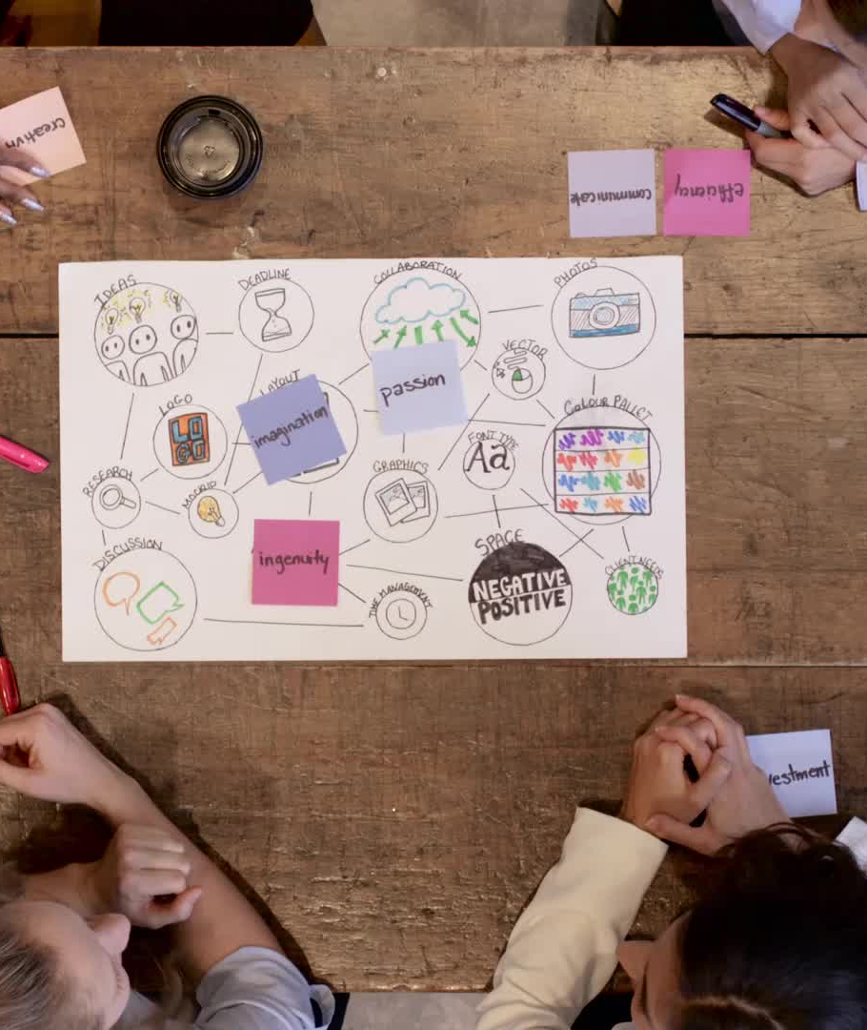
Agile Approach to SLDC
The user stories were used to tell what the Project Owner (stakeholders) required in a finished project. Those stories were used to convey to the team what was required for each point. Presenting it as stories simplifies the presentation for the team and bridges the gap between stakeholders and the team. The user stories along with the definitions of done can then be taken and expanded to provide things that should be tested during the testing phase as well as the expected results. Stories are taken and graded according to priority. User stories tell the story of what the experience looks like from the end user perspective and shows how parts of the project come together to deliver value to the user. In his project, the user stories had to be edited to properly reflect the new requirements of the Product Owner. Due to the project having been created using an Agile approach the changes were simple. Only those stores that were impacted by the change needed to be addressed. In this instance, the user stories having to do with the type of vacations, their picture, and the copy for the heading and description had to be edited.

Slide 17
Waterfall
Waterfall model is a process that requires that before any new steps are started that the previous ones have been completed.
According to Lucid Charts, the Advantages of Waterfall are: -----------
“Uses clear structure”((The Pros and Cons of Waterfall Methodology, 2018)
“Determines the end goal early” (The Pros and Cons of Waterfall Methodology, 2018)
“Transfers information well” (The Pros and Cons of Waterfall Methodology, 2018)
Lucid Charts Lists the Dis-Advantages of Waterfall as: --------------
“Makes changes difficult” (The Pros and Cons of Waterfall Methodology, 2018)
“Excludes the client and/or or end-user” (The Pros and Cons of Waterfall Methodology, 2018)
“Delays testing until after completion” (The Pros and Cons of Waterfall Methodology, 2018)

Slide 18
Pros and Cons of Agile
Addressing the project from a Scrum-agile approach allowed the team to be flexible. Allowing the members to feel empowered in the way they approach the sculpting of the project. Eliminating micromanaging by giving each member personal responsibility as well as the responsibility to all team members. The only thing that I see that might be seen as a con would be the lack of documentation. This might be a problem when there are many stakeholders that may require physical proof of work completed or documentation showing how it will be accomplished. If this project had been done in waterfall things would not have gone as smoothly when the Project Owner made changes to the project. Scrum allowed the changes to be made with minimal effort so it was the best choice.

Slide 19

Agile vs Waterfall
Addressing the project from a Scrum-agile approach allowed the team to be flexible. Allowing the members to feel empowered in the way they approach the sculpting of the project. Eliminating micromanaging by giving each member personal responsibility as well as the responsibility to all team members. The only thing that I see that might be seen as a con would be the lack of documentation. This might be a problem when there are many stakeholders that may require physical proof of work completed or documentation showing how it will be accomplished. If this project had been done in waterfall things would not have gone as smoothly when the Project Owner made changes to the project. Scrum allowed the changes to be made with minimal effort so it was the best choice. When choosing Waterfall or Agile the Project Manager must ascertain if the project is one that follows well-defined steps. This would be things like making a peanut butter and jelly sandwich. In this example, the user must complete certain steps before starting on the next. These types of projects would work well in Waterfall. On the other hand, a project where there can be many tasks being done at one time and also many changes Agile would be a better choice. Another food-related example would be attempting to get a 2-year-old to make a food choice. One minute they want chips and three seconds later a cookie. With these constant changes, a parent would be hard-pressed to accomplish much outside of trying to figure out what their toddler wants. In the given project the change of destination types as well as the late testing of the product could result in there not being a finished project at the end of the project duration due to massive amounts of bugs only becoming apparent during the testing phase.

Slide 20
References
Cobb, C. G. (2015). The Project Manager’s Guide to Mastering Agile. Wiley.
The Pros and Cons of Waterfall Methodology. (2018, August 10). Lucidchart Blog.
https://www.lucidchart.com/blog/pros-and-cons-of-waterfall
methodology#:%7E:text=Advantages%20of%20the%20Waterfall%20model,to%20define%20from%2
0the%20start.
Schwaber, K., & Sutherland, J. (2020). The Scrum Guide [E-book]. Scrum Guides.

